Slide 1

individual tags
01-03-2017

Slide 2
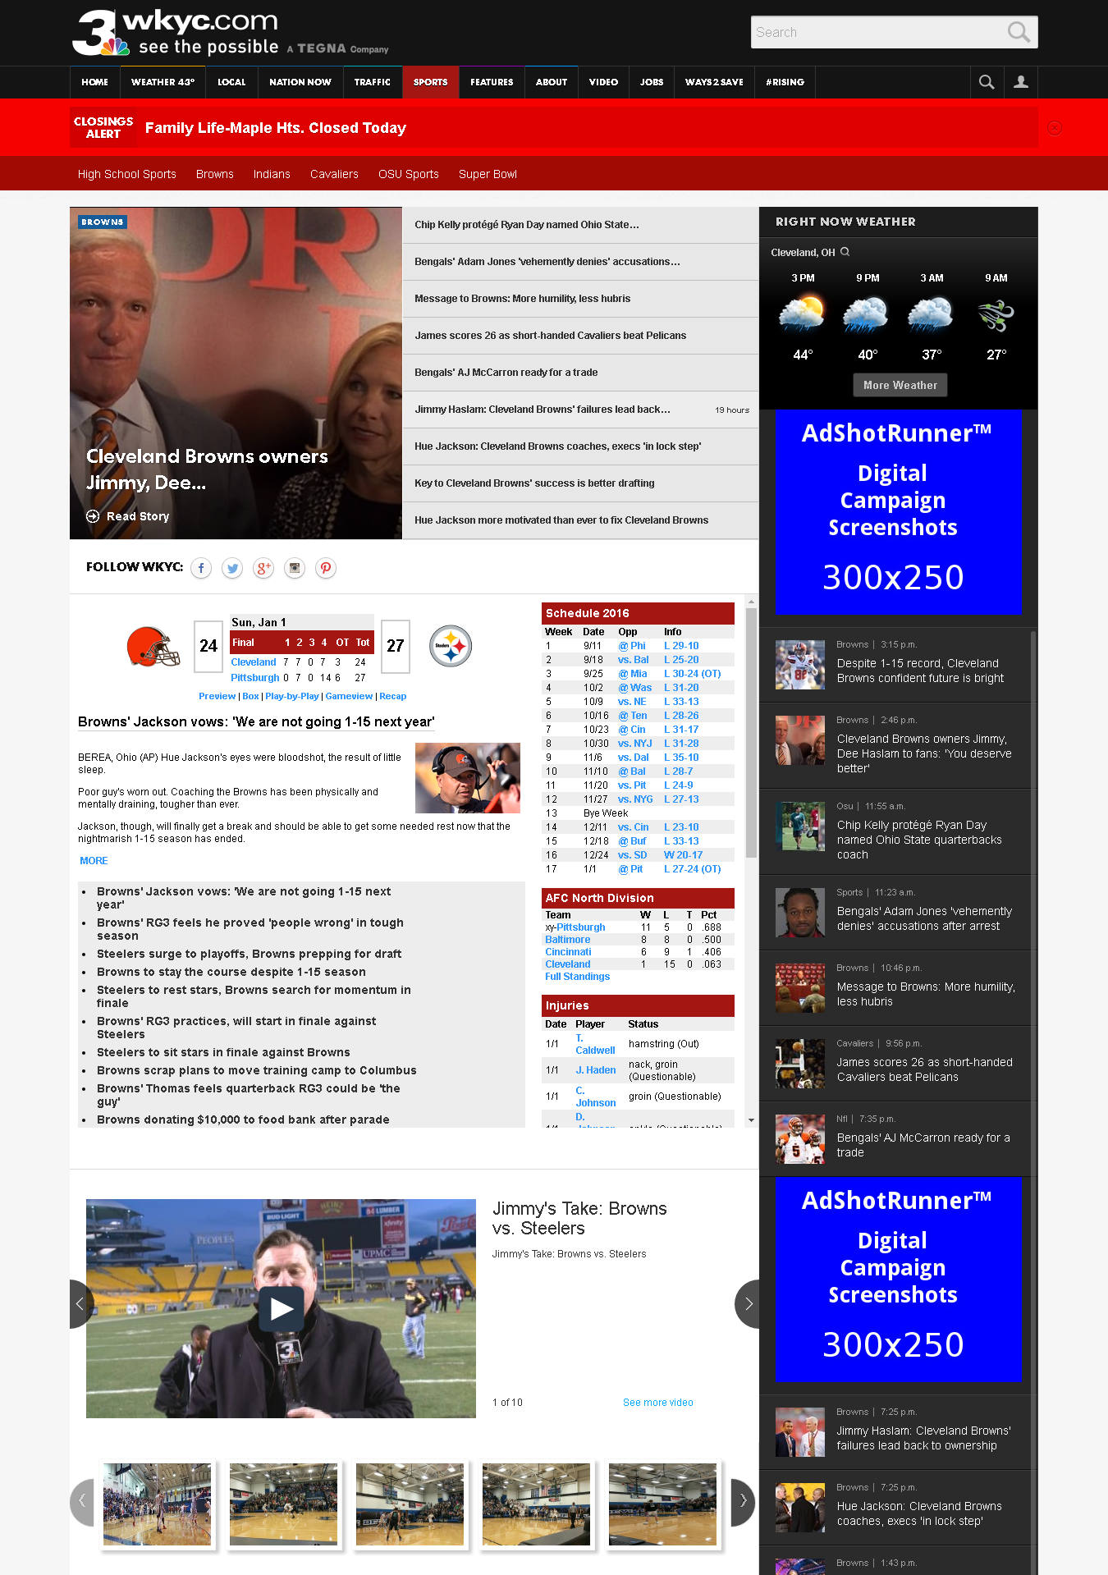
http://www.wkyc.com/sports

Slide 3

http://www.wkyc.com/sports

Slide 4
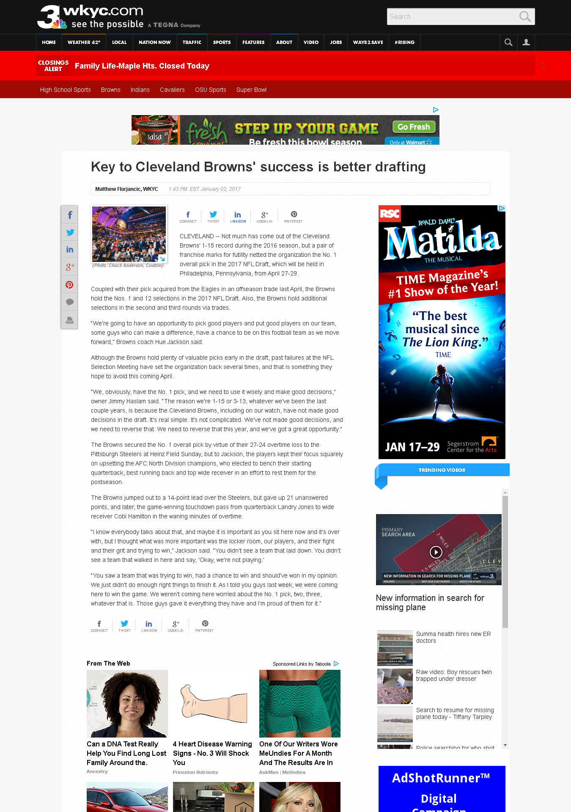
http://www.wkyc.com/sports/nfl/browns/key-to-cleveland-browns-success-is-better-drafting/381283544

Slide 5
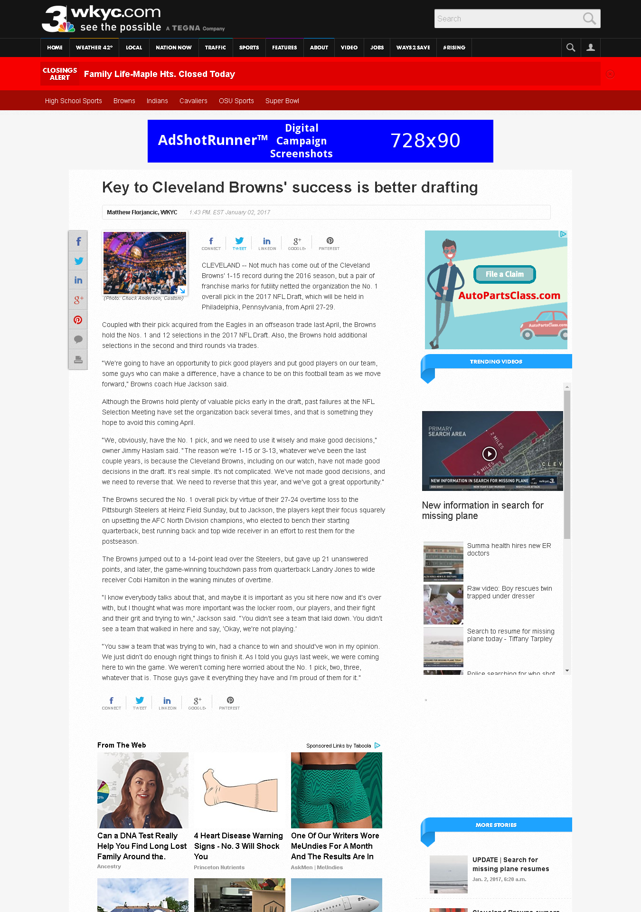
http://www.wkyc.com/sports/nfl/browns/key-to-cleveland-browns-success-is-better-drafting/381283544

Slide 6
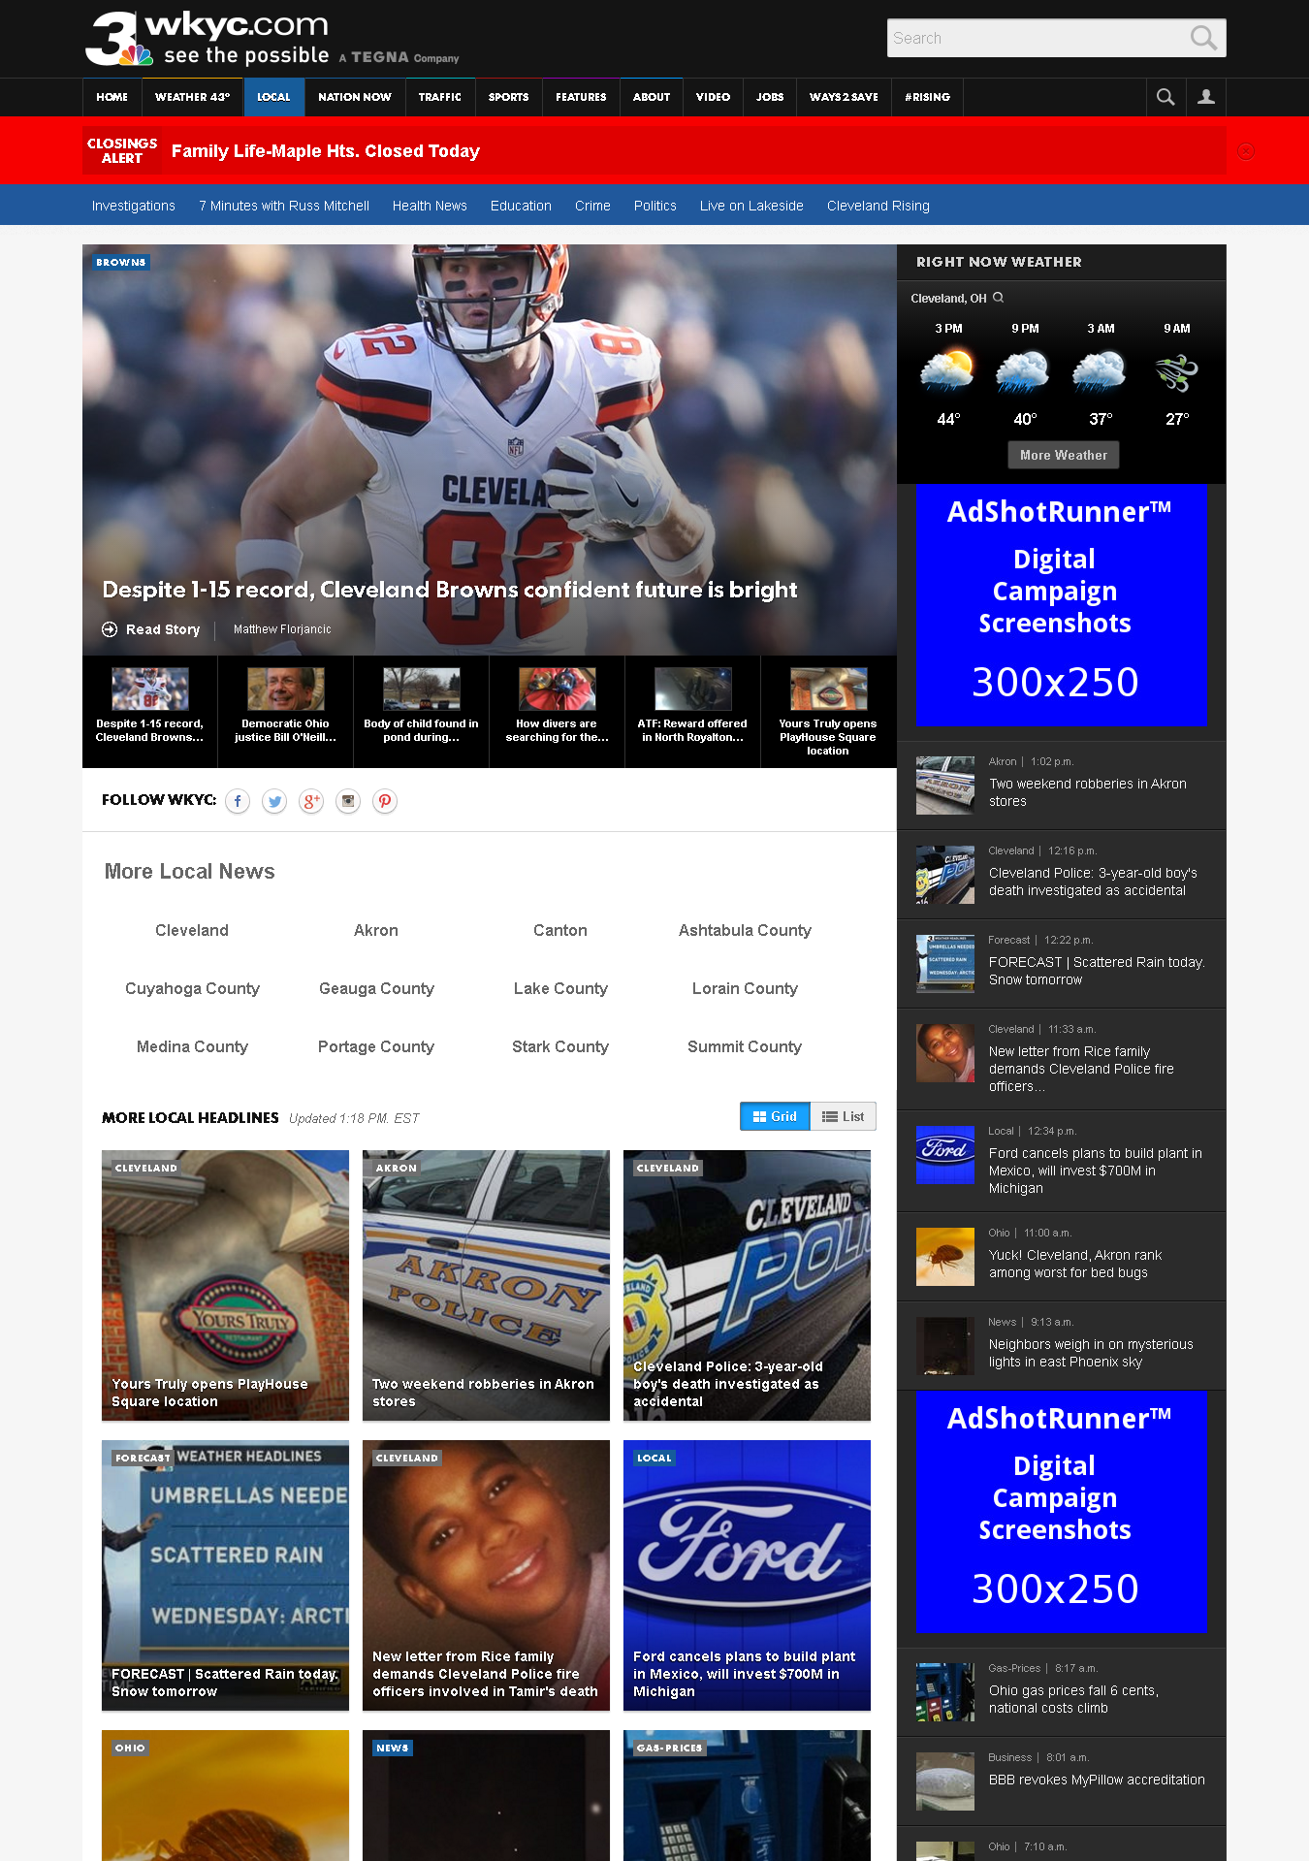
http://www.wkyc.com/local

Slide 7
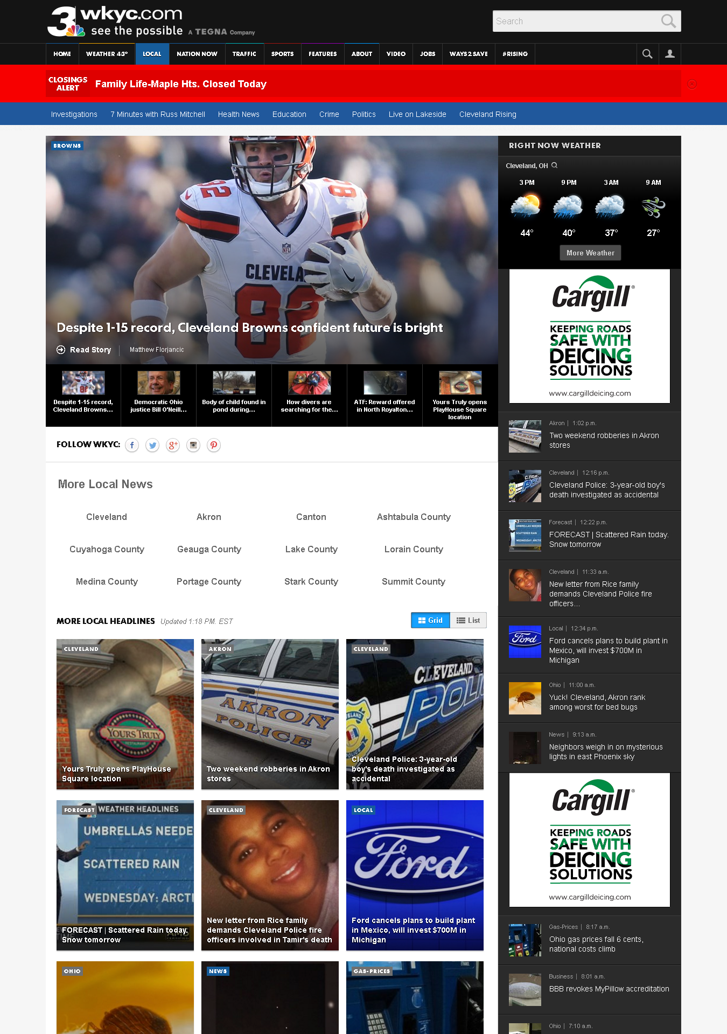
http://www.wkyc.com/local

Slide 8

http://www.wkyc.com/news/local/cleveland/how-divers-are-searching-for-the-missing-plane-in-lake-erie/381618540

Slide 9
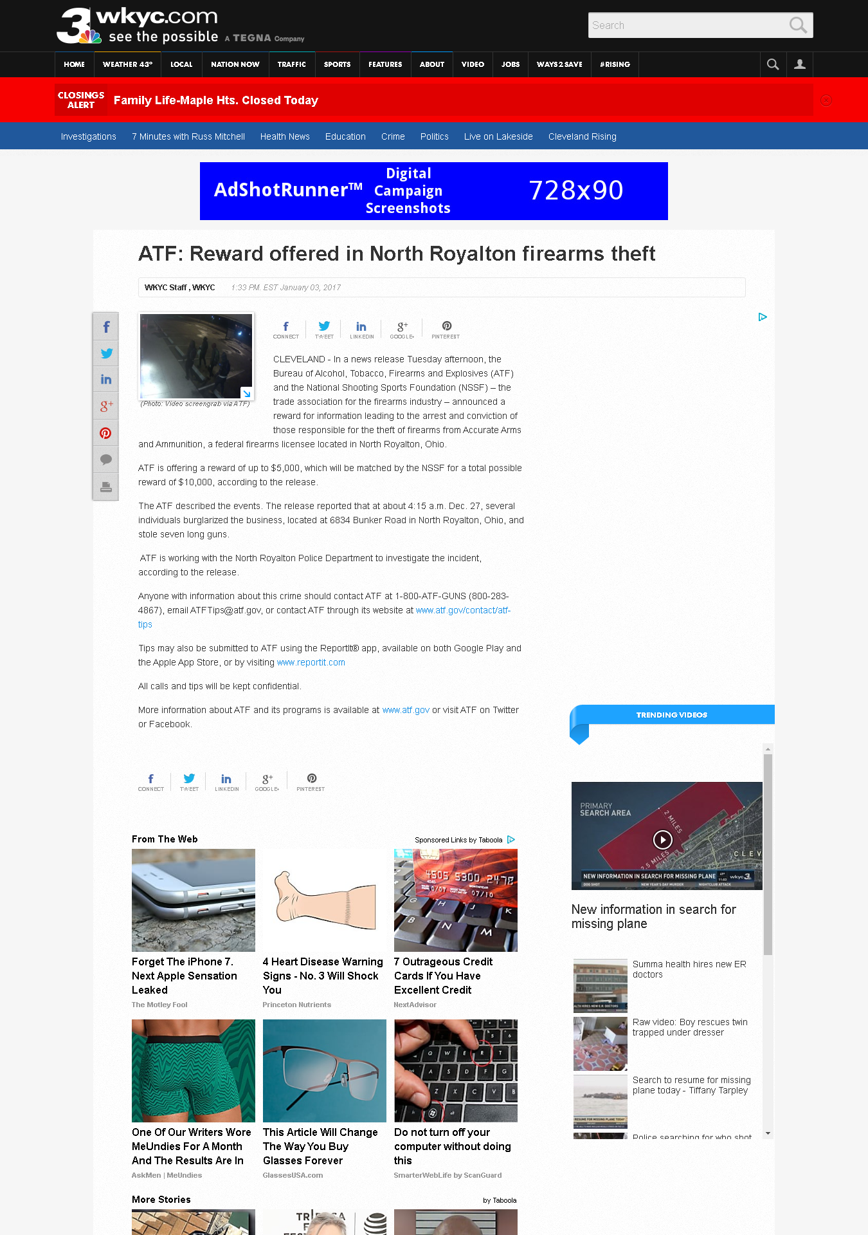
http://www.wkyc.com/news/local/atf-reward-offered-in-north-royalton-firearms-theft/381608093

